Slide 1
Weekly report: Feedback & Lidar – Assisted Controller
Week number: 07
Date: 11/11/2025
Supervisor: Prof. Dr.-Ing. David Schlipf
Group members: Mirza Dincer, Saurabh Pankaj Jha, Midhun Kanichattu Venu
Presenter: Midhun Kanichattu Venu

Slide 2
List of Contents
Tasks of the Week
Use of Optimization method for IEA 3.4 MW
Results of Optimization method
Bladed Interface and Swap Array for Lidar Simulation
EOG Comparison Between Feedback Only and Feedback Feedforward
Conclusion
Midhun Kanichattu Venu - 770588

Slide 3
Tasks of the Week
Use the mapping optimization over DLC 1.2 for IEA 3.4 MW.
Understanding bladed interface and swap array for lidar simulation.
EOG simulation to compare feedback only control and feedback feedforward control.
Midhun Kanichattu Venu - 770588

Slide 4


Kp and Ki Optimization
Starting point (Kp = -12e-3 s, Theta_k = 6° ), is selected based on the original vector of IEA 3.4 MW. Kp is where theta = 0 in original vector, theta is equal to where Kp is half of the selected point.
Based on the starting point, neighboring points will be decided, and each point will be converted to vectors for input of ROSCO
Kp = [-10e-3, -12e-3, -14e-3] , theta_k = [4, 6 ,8]
Ti equal to 1P
$$K_{p_{v}}=K_{p}\left(\frac{1}{1+\frac{θ_{v}}{θ_{k}}}\right)$$
$$K_{i_{v}} =\frac{K_{p_{v}}}{T_{i}}$$
Midhun Kanichattu Venu - 770588

Slide 5
Kp Vectors
Figure 1: Kp Vectors for Optimization over DLC 1.2
Midhun Kanichattu Venu - 770588

Slide 6
Ki Vectors
Figure 2: Ki Vectors for Optimization over DLC 1.2
Midhun Kanichattu Venu - 770588

Slide 7
DLC 1.2 Simulation Settings
660 seconds of simulation. Evaluation of values starts at t = 60 second to get settled values. Additionally, wind wraps around.
DLC 1.2 wind fields with average of 8 m/s to 24 m/s with steps with 4m/s, 3 seeds.
Enabled all DOFs.
Initial conditions of pitch angle, rotor speed and fore-aft tower position for every corresponding wind speed.
Running only feedback controller, no Lidar-assisted controller.
Midhun Kanichattu Venu - 770588

Slide 8
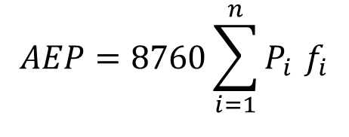
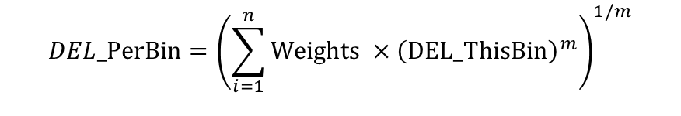
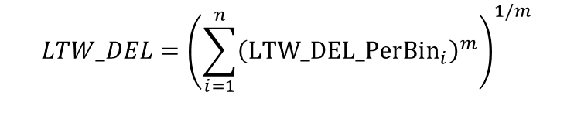
Results
Annual Energy Production (AEP)
Generated power (Pi) is output of the simulation.
Frequency (Fi) is calculated from Weibull distribution, A = 7.5 m/s , k = 2 Rayleigh distribution.
$$AEP=8760\sum_{i=1}^{n}{P_{i}} f_{i}$$
Lifetime Weighted DEL (LTW_DEL)
DEL_ThisBin is the DEL values of tower base fore-aft moment for each wind speed calculated from output of the simulation.
m is equal to Woehler exponent
$$DEL_PerBin={\left(\sum_{i=1}^{n}{Weights ×{\left(DEL_ThisBin\right)}^{m}}\right)}^{1/m}$$
$$LTW_DEL_PerBin={(DEL_PerBin×Weights)}^{1/m}$$
$$LTW_DEL={\left(\sum_{i=1}^{n}{{\left({\text{LTW}\text{_}\text{DEL}\text{_}\text{PerBin}}_{i}\right)}^{m}}\right)}^{1/m}$$
Midhun Kanichattu Venu - 770588

Slide 9
Lifetime Weighted DEL Results
Figure 3: Lifetime Weighted DEL Values for each vector
Midhun Kanichattu Venu - 770588

Slide 10
AEP Results
Figure 4: AEP Values for each vector
Midhun Kanichattu Venu - 770588

Slide 11
Bladed Interface and Swap Array
Bladed Interface,
Serves as the communication link between OpenFAST/Bladed and external controller DLLs.
Uses the legacy Bladed interface for connecting MATLAB, Fortran, or C controllers.
Swap Array (avrSWAP),
A shared data array (avrSWAP) that transfers signals between OpenFAST/Bladed and controller DLLs.
Contains both
inputs (wind speed, rotor speed, pitch)
outputs (pitch, torque, status, time)
Midhun Kanichattu Venu - 770588

Slide 12
WRAPPER.DLL System
Acts as the master DLL coordinating control modules.
Function: Calls sub-DLLs in a specific sequence defined in WRAPPER.IN.
Modules Involved:
LDP.dll
FFP.dll
ROSCO.dll
Midhun Kanichattu Venu - 770588

Slide 13
LDP.dll – Lidar Data Processing
Reads Line-of-Sight (LOS) measurements from the lidar.
Estimates rotor-effective wind speed.
Writes estimated wind speed to avrSWAP array.
Midhun Kanichattu Venu - 770588

Slide 14
LDP.dll – Lidar Data Processing
avrSWAP Index | Signal Name | Direction | Description
63 | L | IN | Base index for lidar data in the avrSWAP array. Used to locate lidar data in the swap array.
L | NewMeasurementFlag | IN | Flag indicating if a new lidar measurement is available (0 = no, 1 = yes).
L + 1 | BeamID | IN | ID of the current lidar beam.
L + 2 | GatesPerBeam | IN | Number of gates in the lidar beam.
L + 2 + iGate | v_los(iGate) | IN | Line-of-sight wind speed measurements for each gate [m/s]. (iGate = 1…GatesPerBeam)
L + 2 + (GatesPerBeam) + 7 | REWS | OUT | Rotor Effective Wind Speed estimated from lidar; written back to avrSWAP.
Midhun Kanichattu Venu - 770588

Slide 15
Feed-Forward Pitch Control
Reads rotor-effective wind speed from avrSWAP.
Filters and time-shifts the signal.
Calculates the feedforward pitch angle from the static pitch curve
Outputs feed-forward pitch rate (time derivative).
Writes pitch rate signal back to avrSWAP.
Midhun Kanichattu Venu - 770588

Slide 16
Feed-Forward Pitch Control
 | avrSWAP Index | Signal Name | Direction | Description
 | 3 | time step | IN | Simulation time step [s]; used by FFP for filtering and pitch rate calculation
 | 63 | L | IN | Starting index in avrSWAP array where lidar-related data begins (set by OpenFAST or LDP.DLL).
 | L + 2 | GatesPerBeam | IN | Number of lidar range gates (for this reference version, only one gate is used).
 | L + 2 + (GatesPerBeam) + 7 | REWS | IN | Rotor Effective Wind Speed (from LDP.DLL) used for feedforward pitch control.
 | L + 2 + (GatesPerBeam) + 8 | REWS_b | OUT | Buffered (time-shifted) filtered REWS signal sent back to OpenFAST.
 | L + 2 + (GatesPerBeam) + 9 | FF_PitchRate | OUT | Feedforward pitch rate (Δθ/Δt) output for ROSCO controller.
 | L + 2 + (GatesPerBeam) + 10 | REWS_f | OUT | Filtered REWS after low-pass filtering — diagnostic output.
Midhun Kanichattu Venu - 770588

Slide 17
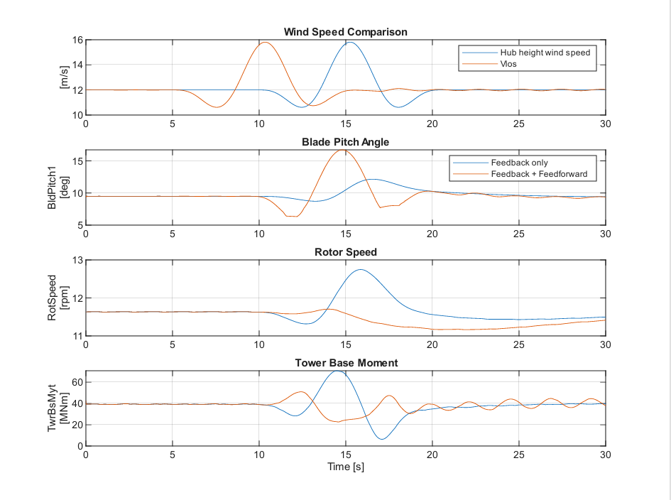
EOG Comparison for 12m/s
Cost for feedback feedforward ("30 s sprint"): 0.639505 (T_buffer 4.5)
Cost for feedback only ("30 s sprint"): 0.983657
Figure 5: Comparison of controllers over 12 m/s EOG
Midhun Kanichattu Venu - 770588

Slide 18
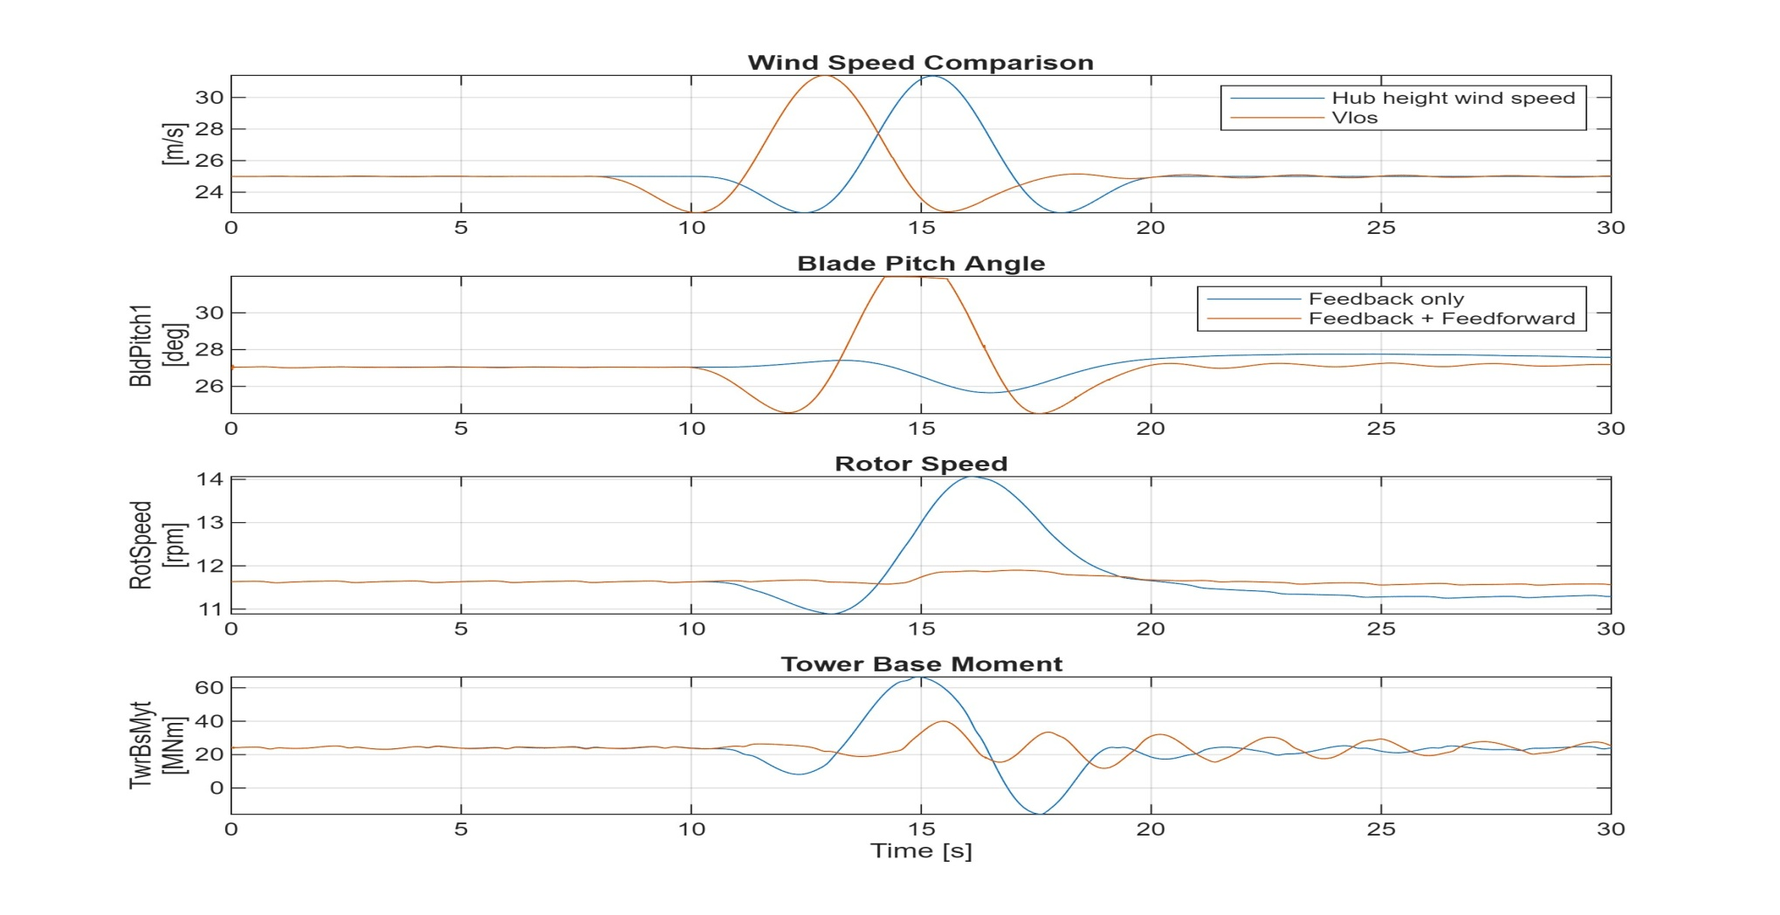
EOG Comparison for 25m/s
Cost for feedback feedforward ("30 s sprint"): 0.813933 (for T_buffer 2)
Cost for feedback only ("30 s sprint"): 1.487102
Figure 6: Comparison of controllers over 25 m/s EOG
Midhun Kanichattu Venu - 770588

Slide 19
Conclusion
Optimization method is tested with IEA 3.4 MW
Understanding how Bladed Interface and swap Array Works in Lidar-Assisted Controller.
EOG simulation comparison between feedback only and feedback feedforward controller.
Next weeks:
Adjust static pitch curve for 25 m/s simulation​
Updating Brute Force Optimization to find global Optimum​
Look into tower damper​
Start with Optimus turbine?
Midhun Kanichattu Venu - 770588

Slide 20
Bibliography
Guo, F., Schlipf, D., & Cheng, P. W. (2023). Evaluation of lidar-assisted wind turbine control under various turbulence characteristics. Wind Energy Science, 8(1), 149–171. https://doi.org/10.5194/wes-8-149-2023
Midhun Kanichattu Venu - 770588

